Slide 1
Agentic Innovation: Standard Skills and Agents For ODA Assets
TM Forum Innovation Hub
September 2026

Slide 2
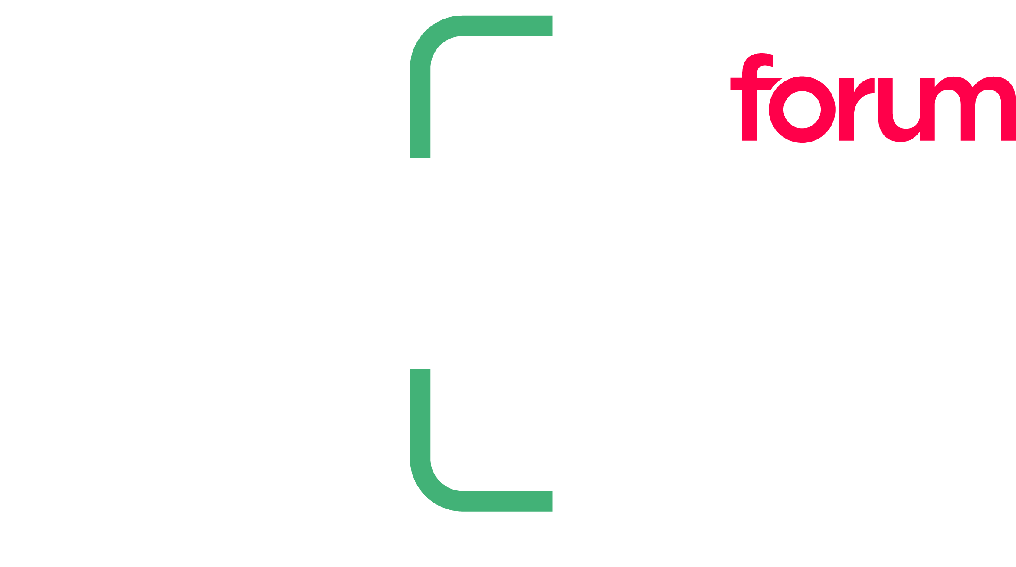
Agenda: AI-SDLC (AIERF)
Why are foundations of ODA critical to AI enabled Software Development lifecycle?
Prior work on create-oda-component agent skill
Scope of AI-SDLC (AIERF)
ODA Skills Marketplace
Overview
How to use?
Example usage
Underpinning Knowledge
Next Steps
Notes:
Excellent so – a “Quick run-through of the agenda today…”
“We’ll start with a quick overview of the Innovation Hub” – What we do & what makes us different?
“Then the main focus — three proposals on
Event Driven ODA Architechture by Dr. Sudhir from Jio,
AI Native Networks by Ravi from NetoAI
AI driven SDLC by Brian Burton
Here's our roadmap for today — we're packing a lot into this session!
Will start off with a quick intro to the Innovation Hub, then straight into the good stuff: three brand-new project proposals – starting with Event driven ODA Architecture by Dr. Sudhir from Jio, AI Native Networks from Jio, NetoAI, and we segway to Brian & Sagar from Vodafone who would introduce the AI Driven SDLC.
Each one of these projects tackles a real industry challenge head-on.
We'll wrap up with next steps and open it up for Q&A.
“And we’ll close with next steps and how to get involved”

Slide 3
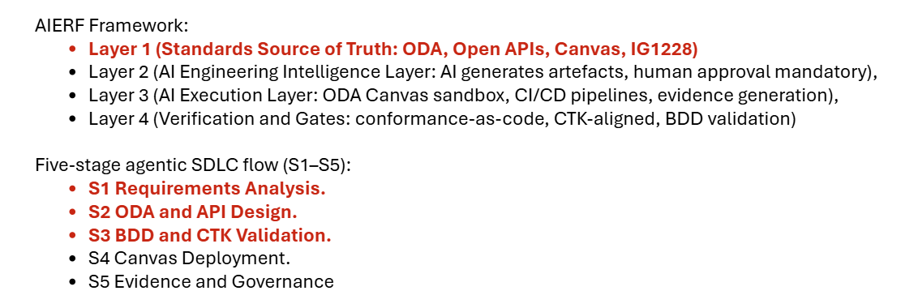
Scope of AI-SDLC (AIERF)

Slide 4
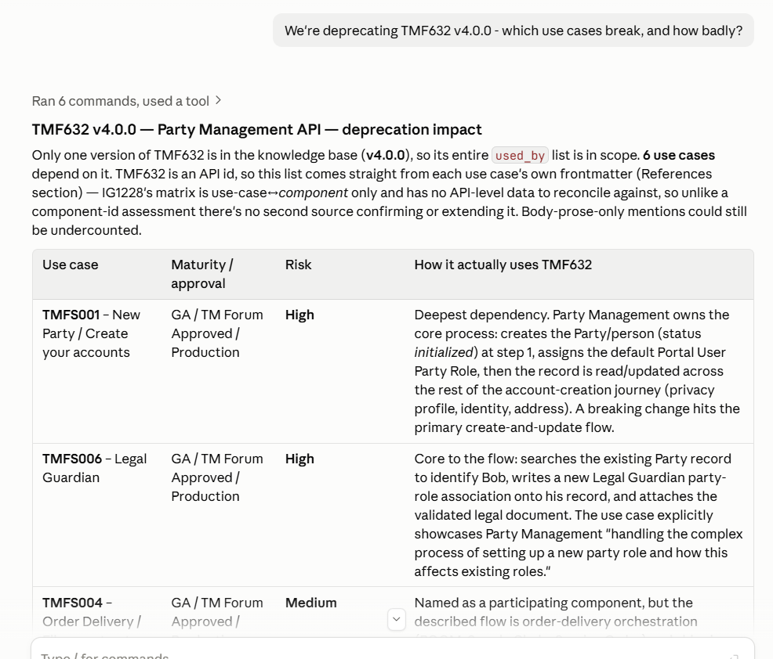

Slide 6
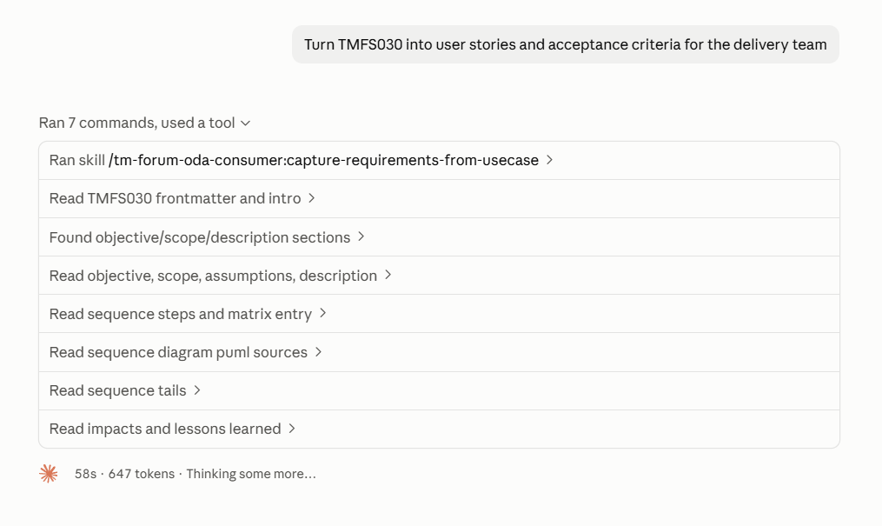

Slide 7
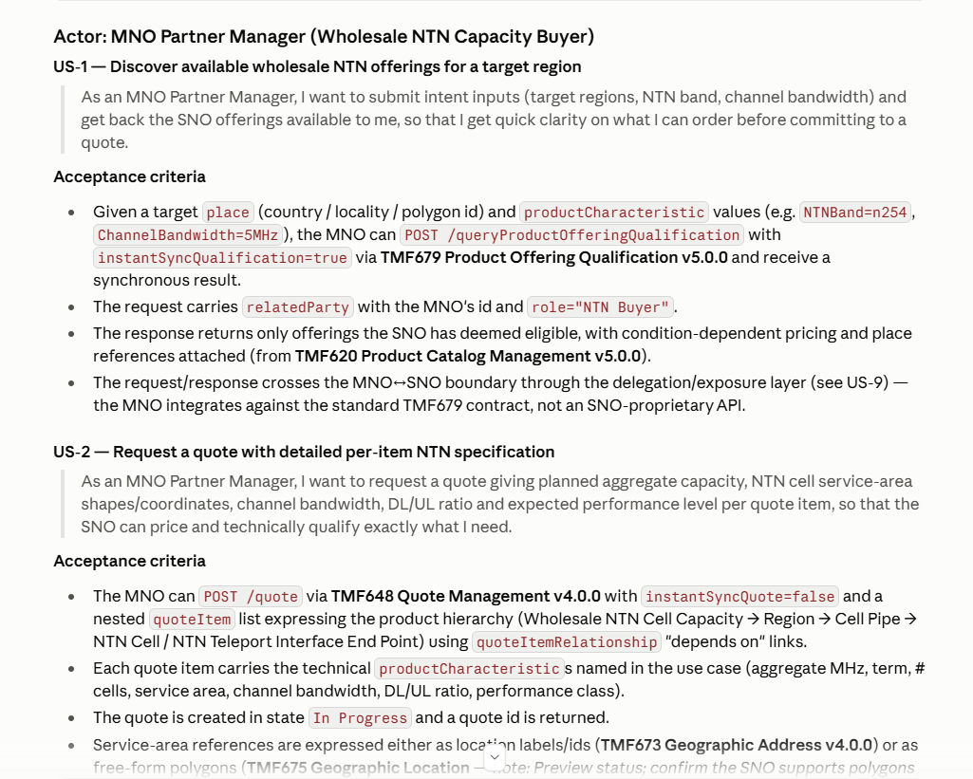

Slide 8
